Slide 1
MOTIF FINDER IN DNA SEQUENCES USING EXPECTATION MAXIMIZATION (EM) ALGORITHM
CS 412 SPRING 2020 PROJECT TEAM:
DEVIN VINCENT TARK - devinvt2
GOWTHAM KUNTUMALLA - gowtham4
XIAOWEI LYU- lv7

Slide 2
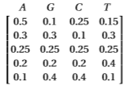
Introduction to Problem
A ‘motif’ is a pattern in a sequence, which is often in the form of ‘position weight matrix’ (PWM). The project involves developing a “motif finding” program and testing it. The three major components of the implementation are:
Building a benchmark
Implementing the “motif finder”
Evaluating the motif finder on the benchmark and making intelligent inferences.
We'll use Expectation-Maximization (EM) as our “motif finder”.
Example of PWM

Slide 3
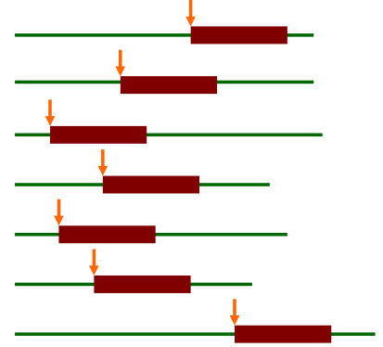
Description of EM Algorithm
The Expectation-Maximization (EM) is a family of algorithms for learning probabilistic models in problems that involve latent variables. The algorithm has four parts:
Initialization
Expectation Step
Maximization Step
Exit condition
Bailey and Elkan uses EM algorithm for discovering motifs in a group of DNA sequences.
Latent variables in motif finding: where the motif starts in each training sequence (sites)

Slide 4
EM Algorithm (at a high level) Pseudocode
EM (dataset, W) {
Initialization: Find the most common subsequences as starting points;
Generate an initial PWM;
While (iterations < n_iter): {
Estimate motif positions Z_ij from motif matrix (E-Step);
Update the PWM from all positions Z_ij (M-Step);
}
}

Slide 5
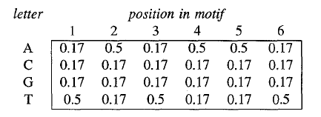
Initializing the Start Point (B&E 1995)
Sequences of length L = motif length are relatively unique
Can create a very small search space of likely Motif Candidates by taking the top ~20 most common subsequences
Initialize the array as below.
Perform expectation step
Choose PWM with maximum likelihood

Slide 6
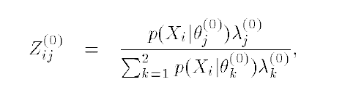
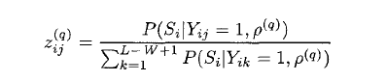
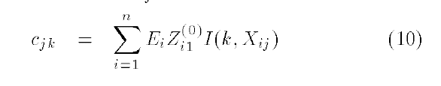
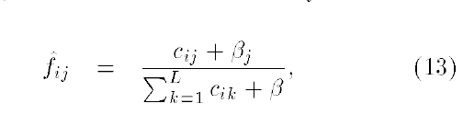
Z Table Updating -> PWM updating
1.
vs.
(1995)
(1994)
Bayesian Counter. Likelihood of a letter being in the motif position indicated by how strong we believe a motif is represented in that position
2.
3.

Slide 7
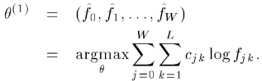
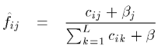
Experiments
We modified the number of iterations n_iter and hyper parameter beta which is used in the calculation of letter frequency in the maximization step. Experiments (-computer simulations) were run using
n_iter∈{10, 100, 500, 1000}
beta∈{0.001, 0.01, 0.02, 0.025, 0.05, 0.1}
Default values that are used in running experiments are n_iter=100 and beta=0.01
Beta is a parameter used in re-estimating θ.

Slide 8
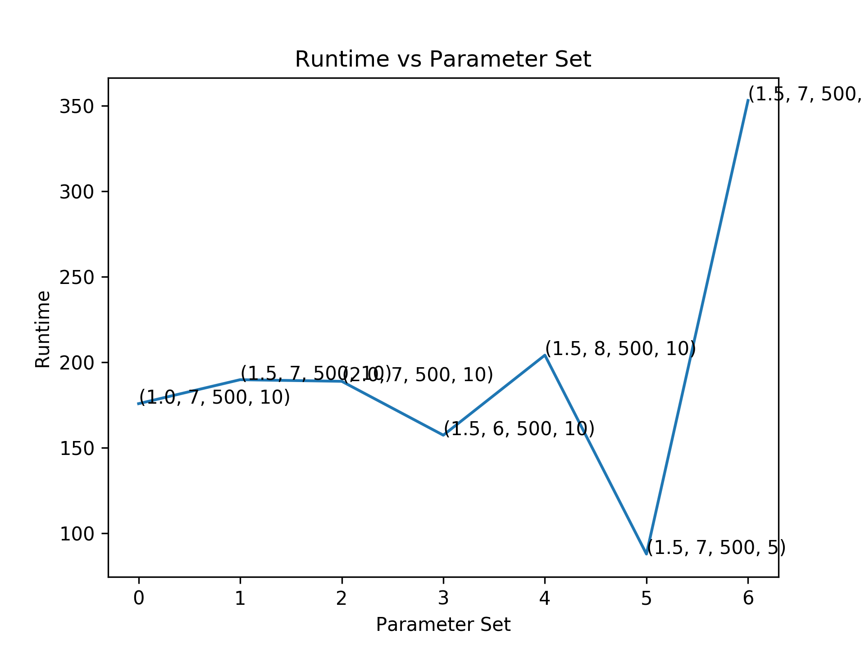
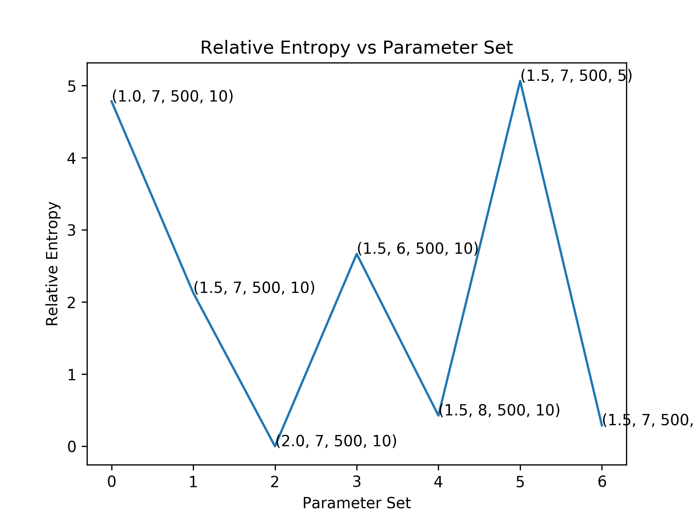
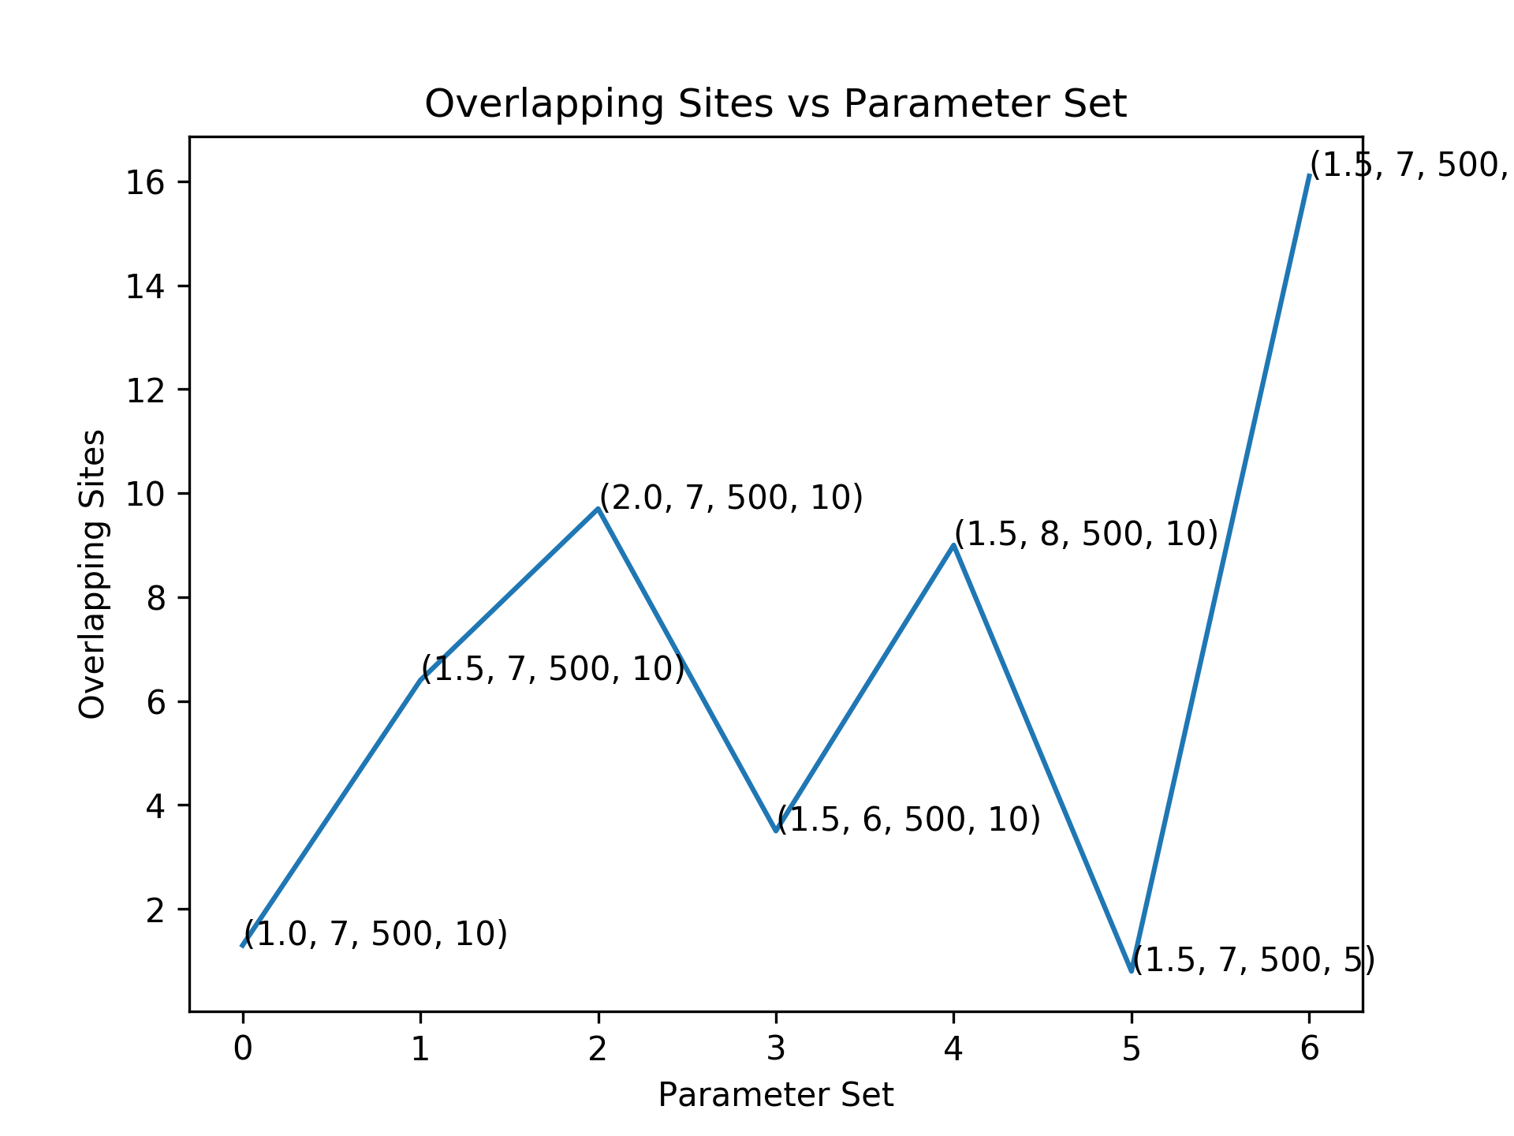
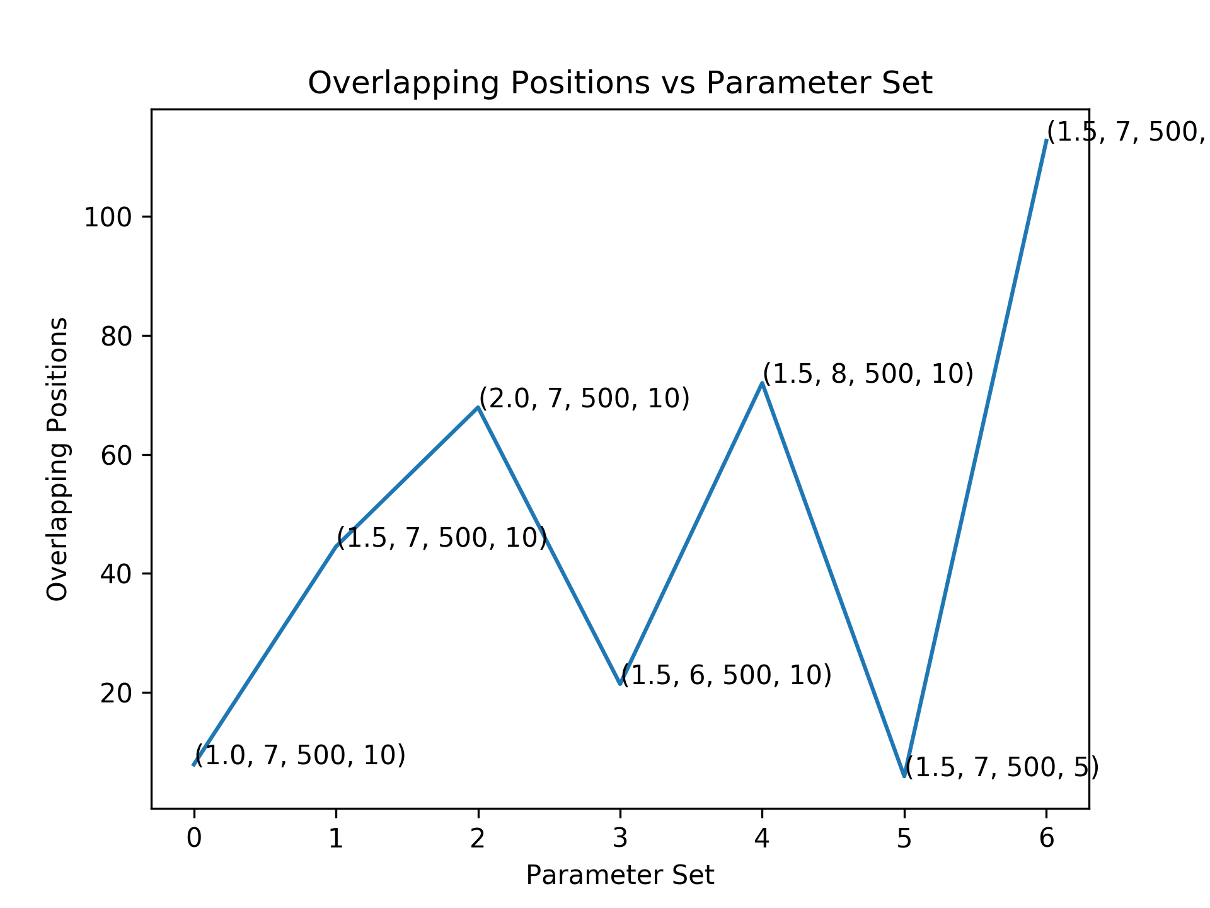
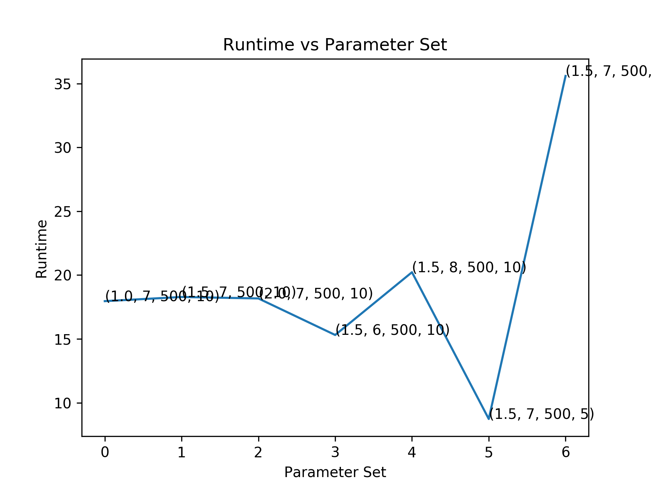

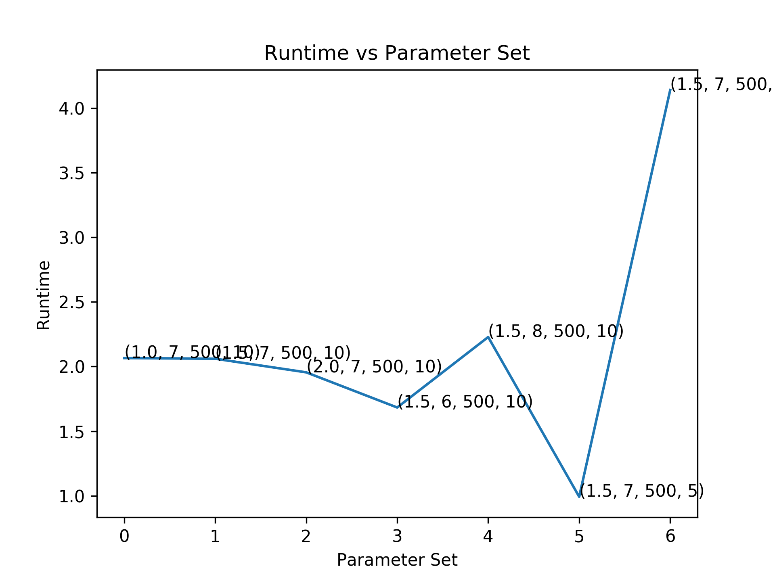
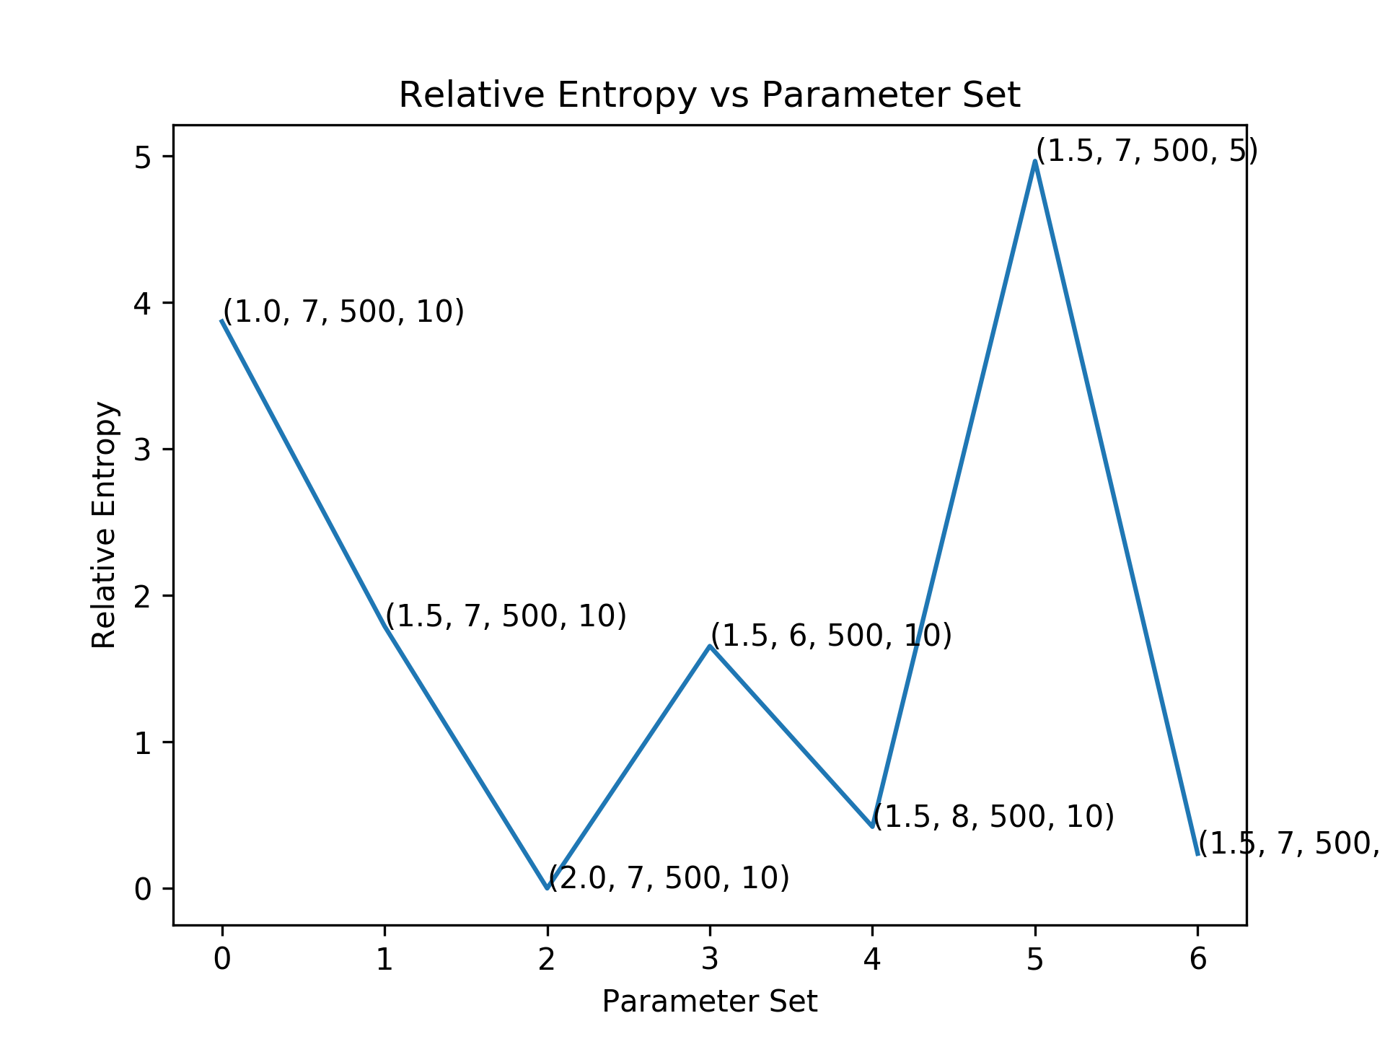
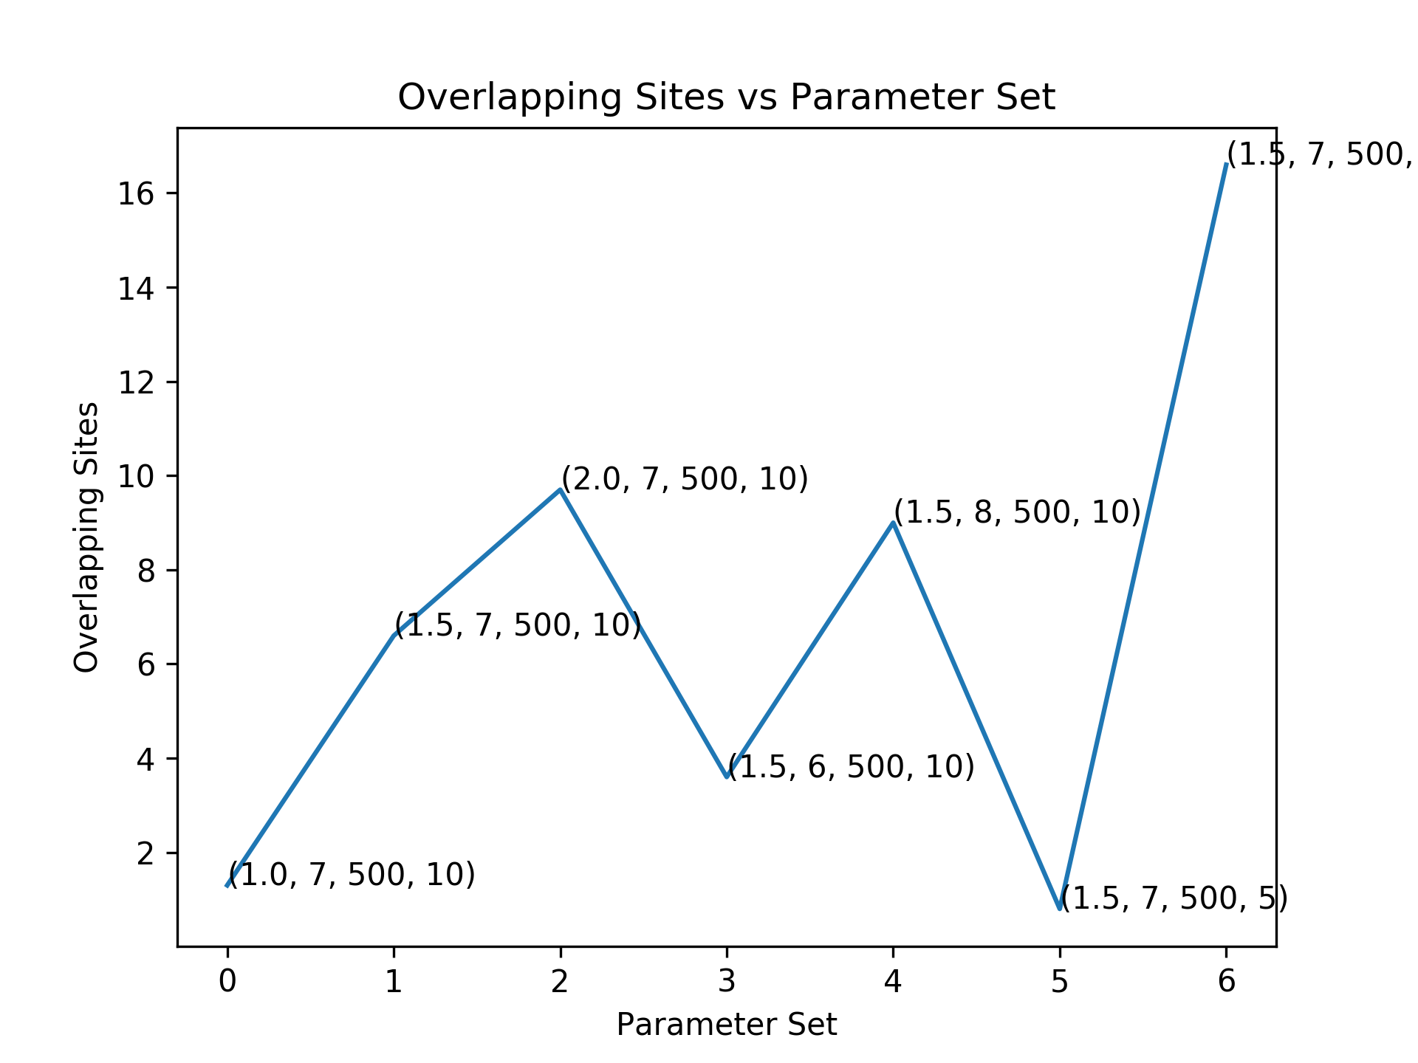
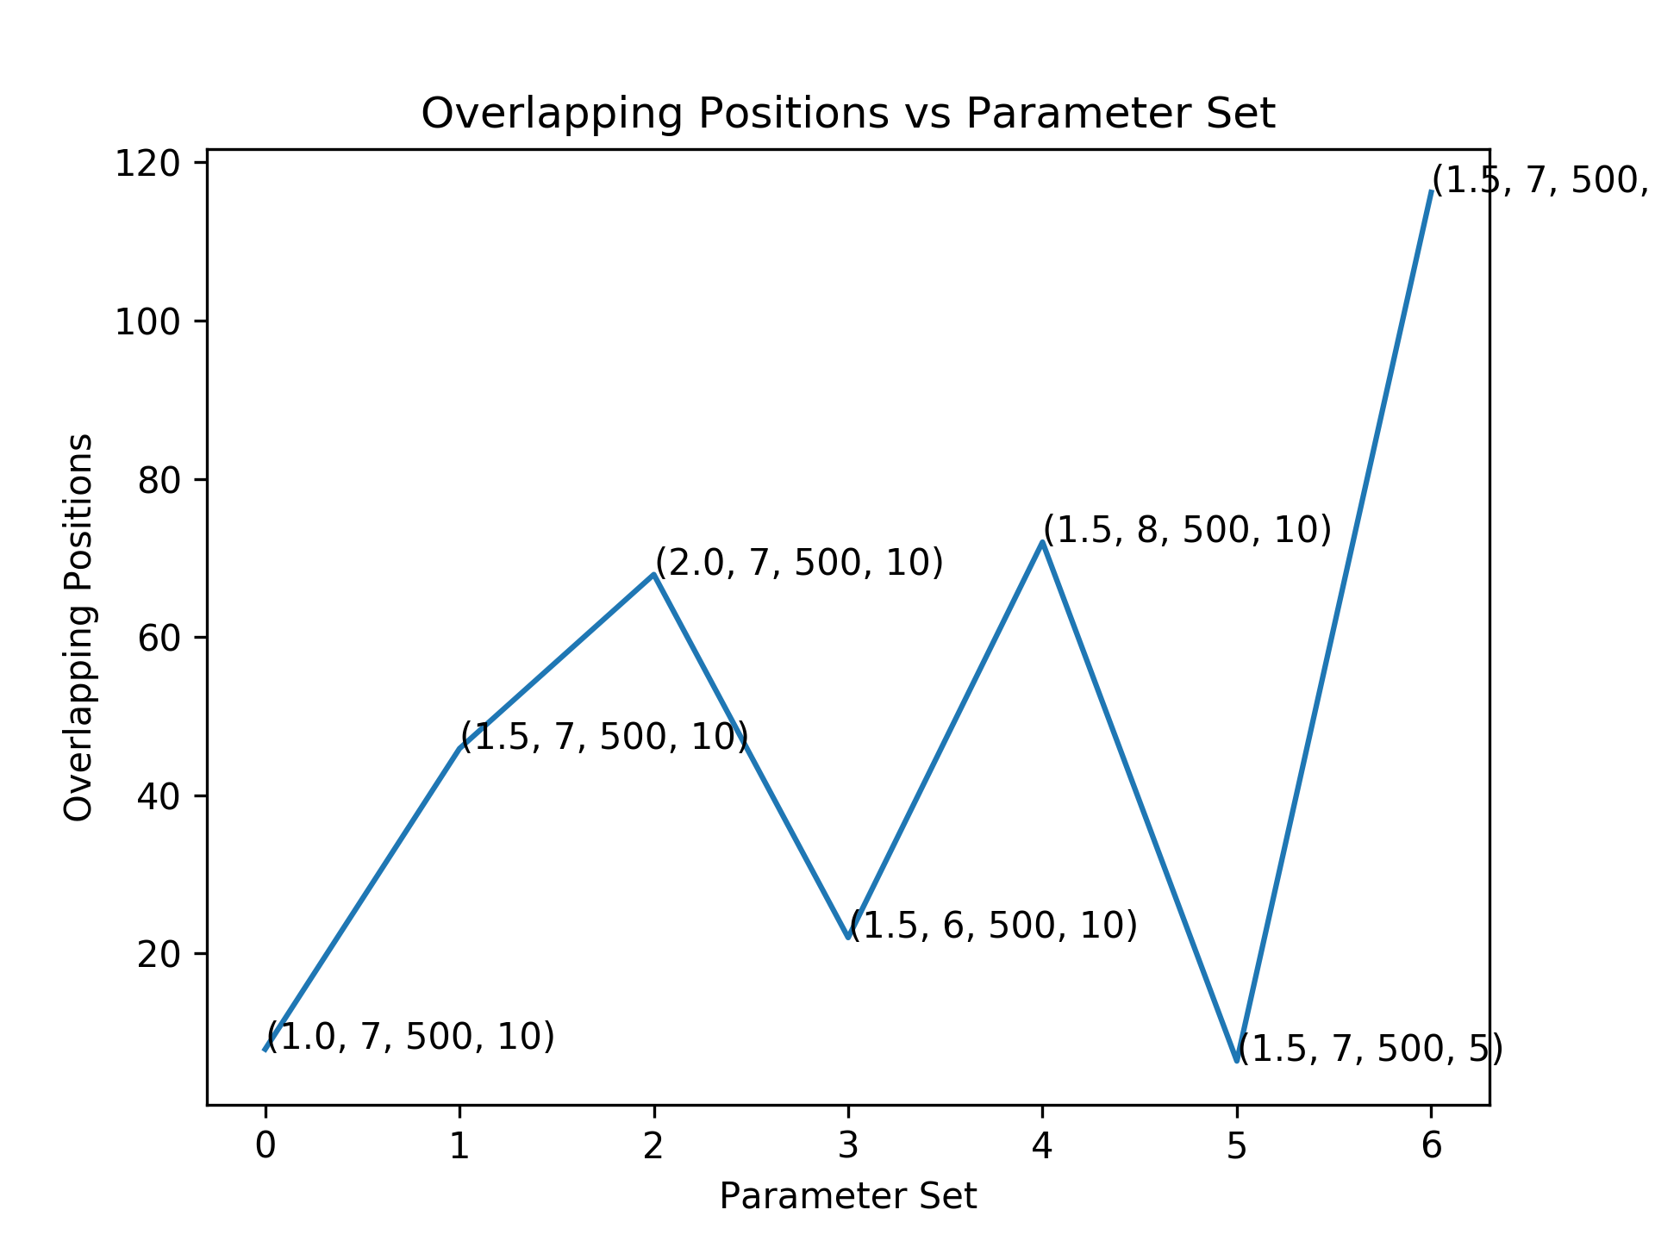
N_iter=1000
Beta=0.01
N_iter=100
Beta=0.01
N_iter=10
Beta=0.01

Slide 9
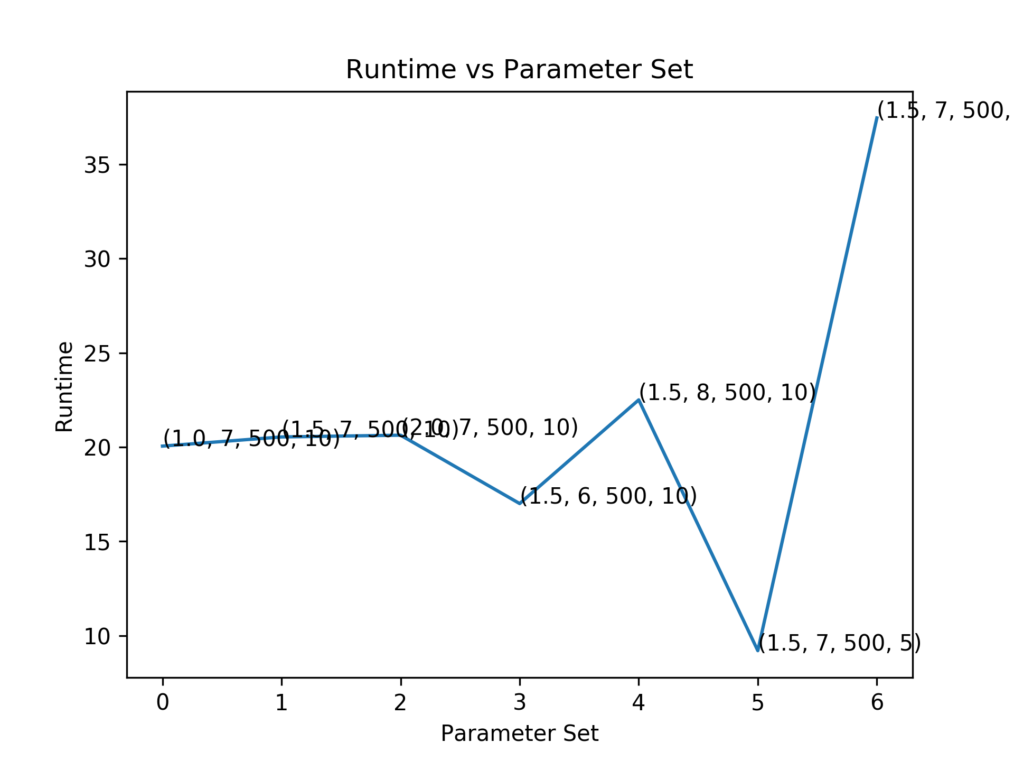

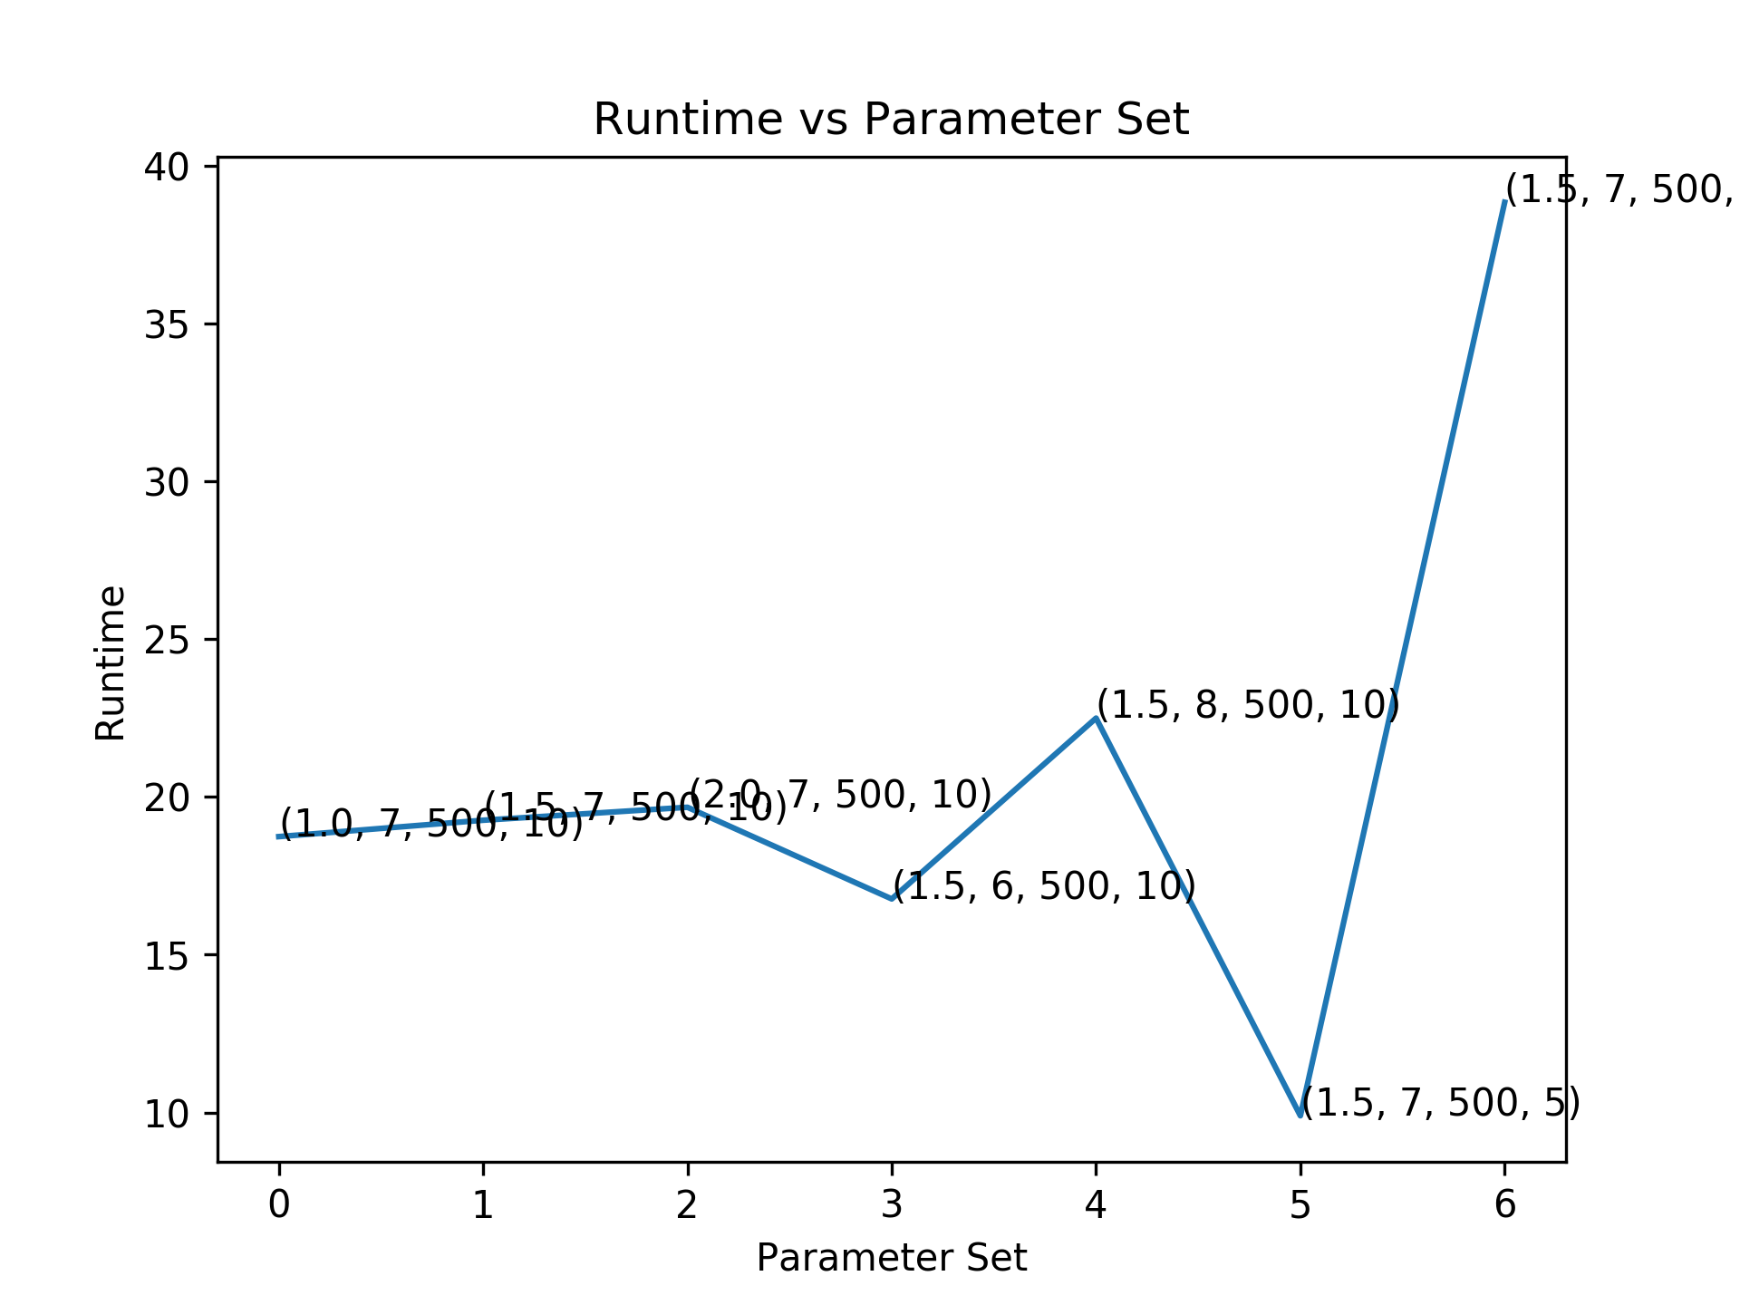




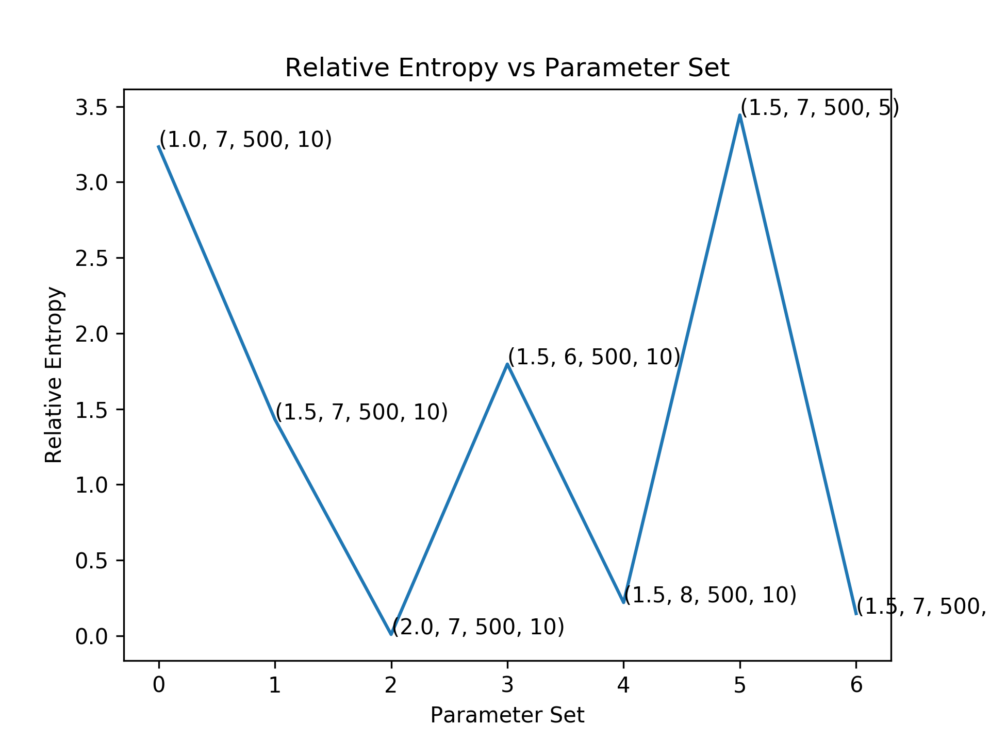

N_iter=100
Beta=0.001
N_iter=100
Beta=0.025
N_iter=100
Beta=0.1

Slide 10
Conclusion
We find that
Initialization is an important step and takes a significant role in finding an optimal solution
Higher information content (ICPC) is associated with better predictions. For instance, this algorithm perfectly predicts the motif sites for ICPC = 2.
Algorithm usually converges for n_iter>100. In case of higher ICPC the convergence is even quicker.
Changing hyper parameter beta doesn’t have a strong trend, but higher values seem to have lower relative_entropy. beta=0.1 has the lowest relative_entropy amongst the tested values.

Slide 11

Thank You
CS412 Instructors
Prof. Saurabh Sinha
TAs

